Slide 1
DATA STRUCTURES & ALGORITHMS

Slide 2
-DATA: -Collection of facts,concepts,figures,observation,occurrence or instructions in formalized manner. Example: Player Name: ”Virat Kohli” (String datatype) Age: 27 (integer datatype) -DATA STRUCTURES: -Particular way of organizing data in memory. Example: Maintain details of all players in a file or database as a data structure.

Slide 3

Data Structure
Data structure affects the design of both structural & functional aspects of a program.
An algorithm is a step by step procedure to solve a problem.

Slide 4
DATA STRUCTURES
PRIMITIVE DATA STRUCTURES
NON PRIMITIVE
DATA STRUCTURES
LINEAR
DATA STRUCTURES
NON LINEAR DATA STRUCTURES
INT
FLOAT
ARRAY
TREES
CHAR
STACK
BOOLEAN
QUEUE
GRAPHS
LINKED LIST

Slide 5
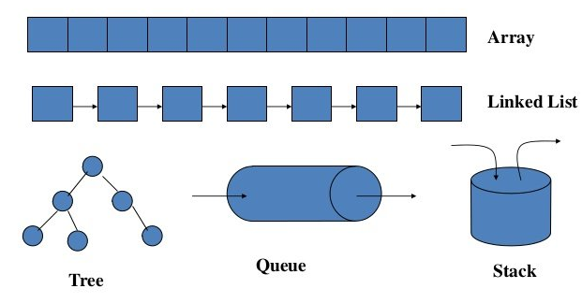

Slide 6
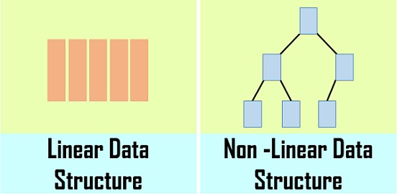

Slide 7
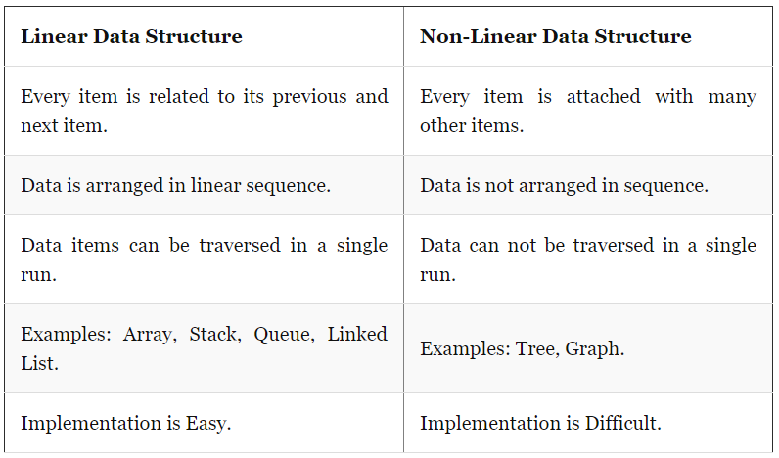

Slide 8
Linked Lists

Slide 9
LINKED LIST: -Ordered collection of series of nodes, which are not necessarily adjacent in memory. -Each node contains two fields. -DATA field: Holds information or data -NEXT field: Pointer which holds the address of next node Structure of node :
DATA | NEXT

Slide 10
Linked List
Properties
Successive elements are connected by pointers
Last element points to NULL
Can grow or shrink in size during execution of a program
Can be made just as long as required (until system memory)
It does not waste memory space (but takes some extra memory for pointers

Slide 11
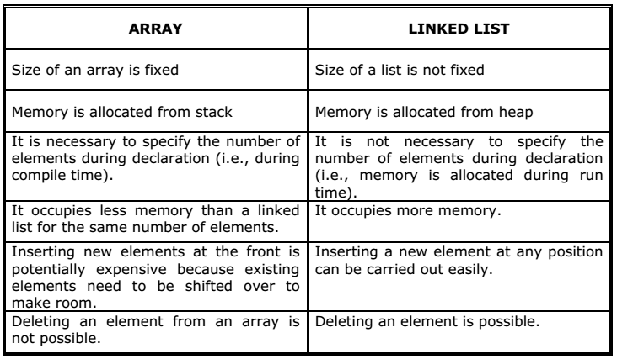
Linked List Vs Array

Slide 12
Linked List
Advantages
Linked List is Dynamic data Structure . i.e can grow and shrink during run time.
Insertion and Deletion Operations are Easier
Efficient Memory Utilization . i.e no need to pre-allocate memory
Faster Access time
Linear Data Structures such as Stack, Queue can be easily implemented using Linked list

Slide 13
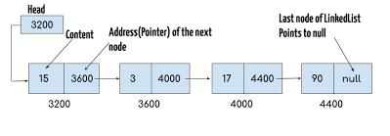
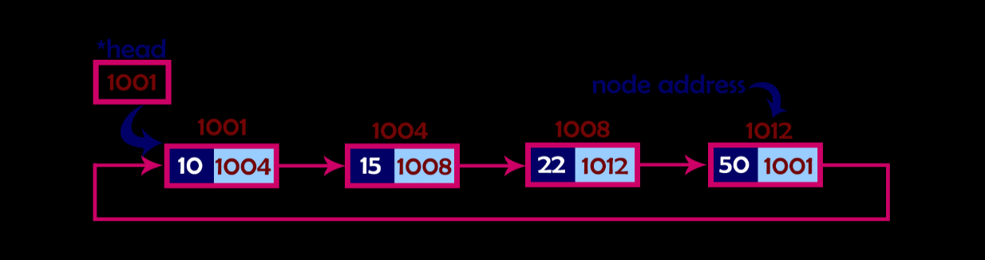
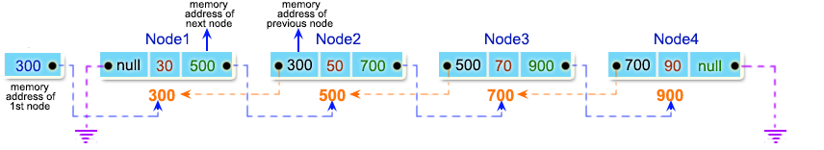
Linked List
Types of Linked List
Singly linked list
Doubly linked list
Circular linked list

Slide 14
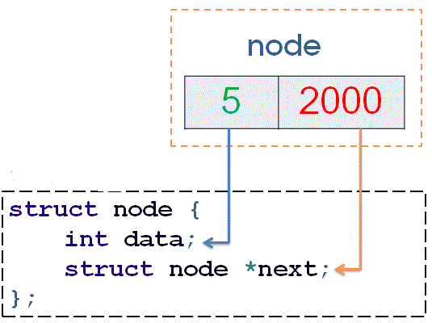
SINGLY LINKED LIST -Structure is used to represent each node and pointer is used to represent address of nodes. struct node { int data; struct node* next; }

Slide 15
Singly Linked List
Major Operations
Creation
Insertion : First, Last, Middle
Deletion: First, Last, Middle
Search
Display

Slide 16
Empty List
Empty Linked list is a single pointer having the value of NULL.
head = NULL;
head

Slide 17
CREATE NODE
struct node
{
int data;
struct node* next;
}*head=NULL,*newnode=NULL,*pos=NULL;

Slide 18
Creation of Linked List: void create() { int value; newnode=new node(); cout<<"Enter Data:"; cin>>value; newnode->data=value; newnode->next=NULL; if(head==NULL) { head=newnode; pos=newnode; } else { pos->next=newnode; pos=newnode; } }

Slide 19
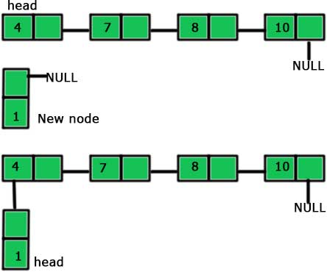
Singly Linked List : Insertion
At First
Before
After

Slide 20
Insertion in the first: void insert_first() { int value; newnode=new node(); cout<<"Enter Data:"; cin>>value; newnode->data=value; newnode->next=NULL; if(head==NULL) { head=newnode; pos=newnode; } else { newnode->next=head; head=newnode; } }

Slide 21
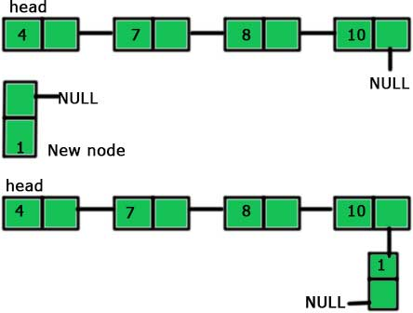
Singly Linked List : Insertion
At Last
Before
After

Slide 22
Insertion in the Last: void insert_last() { int value; newnode=new node(); cout<<"Enter Data:"; cin>>value; newnode->data=value; newnode->next=NULL; if(head==NULL){ head=newnode; pos=newnode; } else{ pos=head; while(pos->next!=NULL) pos=pos->next; pos->next=newnode; } }

Slide 23
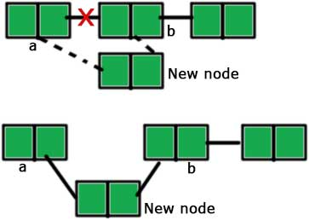
Singly Linked List : Insertion
At Middle
Before
After

Slide 24
Insertion in the middle: void insert_middle() { int value,aftervalue; newnode=new node(); cout<<"Enter Data:"; cin>>value; newnode->data=value; newnode->next=NULL; if(head==NULL){ head=newnode; pos=newnode; } else { cout<<"Enter data after which insertion is to be done:"; cin>>aftervalue; pos=head; while(pos!=NULL&&pos->data!=aftervalue) pos=pos->next; newnode->next=pos->next; pos->next=newnode; }}

Slide 25
DISPLAY void display() { int count=0; if(head==NULL){ cout<<"List is Empty"; return; } else{ pos=head; while(pos!=NULL) { count++; cout<<pos->data<<" "<<pos->next<<" "; pos=pos->next; } cout<<"\n NO OF ELEMENTS:"<<count; } }

Slide 26
DISPLAY IN REVERSE: void displayrev(struct node *pos) { if(head==NULL) return; else displayrev(head->next); cout<<head->data<<" "; }

Slide 27

Search void search_list(){ int value,flag=0; cout<<"Enter the value to be searched:"; cin>>value; if(head==NULL){ cout<<"List is Empty"; return; } else{ for(pos=head;pos!=NULL;pos=pos->next) { if(pos->data==value) { flag=1; break; } } if(flag==1) cout<<"Element found"; else cout<<"Element not found";}}

Slide 28
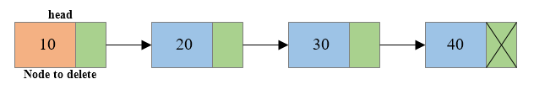

Singly Linked List : Deletion
At First
Before
After
Steps:
Assign temporary name to first node
Nominate neighbour node as header node
Disconnect the first node connection
Free the memory occupied by first node

Slide 29
Deletion in the First void delete_first() { struct node* delnode; if(head==NULL) { cout<<"List is Empty"; return; } else { pos=head; head=pos->next; delnode=pos; delete delnode; } }

Slide 30
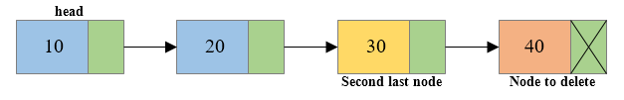
Singly Linked List : Deletion
At Last
Before
After
Steps:
Traverse to the last node by keeping track of the second last node
Disconnect the second last node with the last node
Free the memory occupied by last node

Slide 31
Deletion in the Last void delete_last() { struct node* prev; if(head==NULL) { cout<<"List is Empty"; return; } else { pos=head; while(pos->next!=NULL) { prev=pos; pos=pos->next; } prev->next=NULL; delete pos; }}

Slide 32
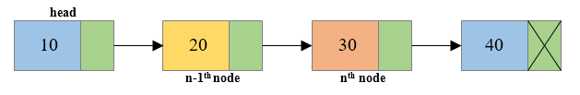
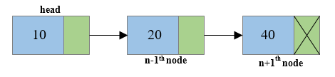
Singly Linked List : Deletion
At Middle
Before
After
Steps:
Traverse to the n^{th} node of the singly linked list and also keep reference of n-1th node
Reconnect the n-1th node with the n+1th node
Free the memory occupied by the n^{th} node

Slide 33
void delete_middle()
{
struct node* prev;
int value;
if(head==NULL){
cout<<"List is Empty";
return;
}
else{
cout<<"Enter the data to be deleted:";
cin>>value;
pos=head;
while(pos->data!=value&&pos!=NULL)
{
prev=pos;
pos=pos->next;
}
prev->next=pos->next;
delete pos;
}}

Slide 34
Singly Linked List
Advantages
Access all nodes in forward direction
It is a dynamic data structure
Occupies very less memory. i.e has only one pointer
Dis-Advantages
Backward direction is not possible
For traversing: it is a time consuming process

Slide 35

CIRCULARLY LINKED LIST: -A circular linked list is a sequence of elements in which every element has a link to its next element in the sequence and the last element has a link to the first element. -Circular linked list is similar to the single linked list except that the last node points to the first node in the list.

Slide 36

CREATION: void create() { int value; struct node*first; newnode=new node(); cout<<"Enter Data:"; cin>>value; newnode->data=value; newnode->next=NULL; if(head==NULL){ head=newnode; newnode->next=head; first=pos=newnode; } else{ first=pos=head; while(pos->next!=first) pos=pos->next; pos->next=newnode; newnode->next=first; } }

Slide 37
INSERTION AT THE FIRST POSITION: void insert_first() { int value; struct node*first; newnode=new node(); cout<<"Enter Data:"; cin>>value; newnode->data=value; newnode->next=NULL; if(head==NULL) { head=newnode; newnode->next=head; first=pos=newnode; } else { first=pos=head; while(pos->next!=first) pos=pos->next; pos->next=newnode; newnode->next=first; head=newnode; } }

Slide 38
INSERTION AT THE END: void insert_last() { int value; struct node*first,*last; newnode=new node(); cout<<"Enter Data:"; cin>>value; newnode->data=value; newnode->next=NULL; if(head==NULL){ head=newnode; newnode->next=head; first=pos=newnode; } else{ pos=head; first=head; while(pos->next!=first) pos=pos->next; pos->next=newnode; newnode->next=first; }}

Slide 39
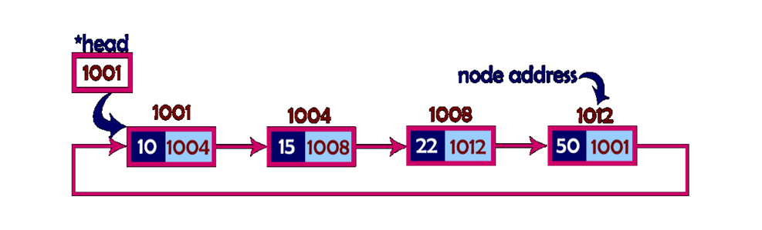
DELETION IN THE FIRST POSITION: void delete_first() { struct node* delnode,*first; if(head==NULL) { printf("List is Empty"); return; } else { first=head; pos=head; head=first->next; while(pos->next!=first) pos=pos->next; pos->next=head; delnode=first; delete delnode; } }

Slide 40
DELETION IN THE LAST POSITION: void delete_last() { struct node* prev,*first; if(head==NULL) { cout<<"List is Empty"; return; } else { pos=head; first=head; while(pos->next!=head) { prev=pos; pos=pos->next; } prev->next=first; delete pos; }}

Slide 41
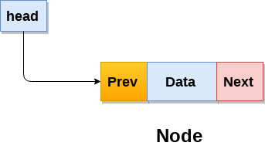
DOUBLY LINKED LIST: -Doubly linked list is a sequence of elements in which every element has links to its previous element and next element in the sequence. STRUCTURE OF NODE:

Slide 42
Doubly Linked List
Major Operations
Creation
Insertion : First, Last, Middle
Deletion: First, Last, Middle
Search
Display

Slide 43
CREATE NODE struct node { int data; struct node* next,*prev; }*head=NULL,*newnode=NULL,*pos=NULL;

Slide 44
CREATION OF NODE: void create() { int value; newnode=new node(); cout<<"Enter Data:"; cin>>value; newnode->data=value; newnode->next=NULL; newnode->prev=NULL; if(head==NULL) { head=newnode; pos=newnode; } else { pos->next=newnode; newnode->prev=pos; pos=newnode; } }

Slide 45
void insert_first()
{
struct node*temp;
int value;
newnode=new node();
cout<<"Enter Data:";
cin>>value;
newnode->data=value;
newnode->next=NULL;
newnode->prev=NULL;
if(head==NULL)
{
head=newnode;
pos=newnode;
}
else
{
temp=head;
newnode->next=head;
head=newnode;
temp->prev=newnode;
}
}

Slide 46
INSERTION AT THE END OF THE LIST void insert_last() { int value; newnode=new node(); cout<<"Enter Data:"; cin>>value; newnode->data=value; newnode->next=NULL; newnode->prev=NULL; if(head==NULL) { head=newnode; pos=newnode; } else { pos=head; while(pos->next!=NULL) pos=pos->next; pos->next=newnode; newnode->prev=pos; pos=newnode; } }

Slide 47
INSERTION IN THE MIDDLE: void insert_middle() { struct node *A,*B; int value,aftervalue; newnode=new node(); cout<<"Enter Data:"; cin>>value; newnode->data=value; newnode->next=NULL; newnode->prev=NULL; if(head==NULL) { head=newnode; pos=newnode; } else { cout<<"Enter data after which insertion is to be done:"; cin>>aftervalue; pos=head; while(pos!=NULL&&pos->data!=aftervalue) pos=pos->next; A=pos; B=pos->next; A->next=newnode; B->prev=newnode; newnode->prev=A; newnode->next=B; } }

Slide 48
DELETION IN THE FRONT: void delete_first() { struct node *delnode,*first,*second ; if(head==NULL) { cout<<"List is Empty"; return; } else { first=head; second=first->next; second->prev=NULL; head=second; delnode=first; delete delnode; } }

Slide 49
DELETE LAST void delete_last() { struct node *previous; if(head==NULL) { cout<<"List is Empty"; return; } else { pos=head; while(pos->next!=NULL) { previous=pos; pos=pos->next; } previous->next=NULL; delete pos; } }

Slide 50
DELETION IN THE MIDDLE: void delete_middle() { struct node *previous,*A,*B; int value; if(head==NULL) { cout<<"List is Empty"; return; } else { cout<<"Enter the data to be deleted:"; cin>>value; pos=head; while(pos->data!=value) { previous=pos; pos=pos->next; } A=previous; B=pos->next; A->next=B; B->prev=A; delete pos; } }

Slide 51
Doubly Linked List
Advantages
Allows traversal of nodes in both direction which is not possible in singly linked list
Deletion of nodes is easy when compared to singly linked list
Reversing the list is simple and straightforward.
DisAdvantages
It uses extra memory when compared to array and singly linked list
Elements are accessed sequentially no direct access is allowed

Slide 52
Time Complexity
 | Array | Linked List
Search | O(n) | O(n)
Insert | O(1) | O(1)
Remove | O(n) | O(n)

Slide 53
STRUCTURE struct student { int regno; float mark1,mark2,mark3; }

Slide 54
POINTERS IN C++

Slide 55
EXAMPLE OF VARIABLES AND STORAGE
int a=10; a
2002
float y=12.314567; y
3004
double dvalue=34.13678235; dvalue
5001
char opt=‘s’; opt
9100
10
12.314567
34.13678235
s

Slide 56
POINTERS
A variable that stores/points the address of another variable.
Used to allocate memory dynamically i.e. at run time.
Pointer variable might be of any data type such as int, float, char, double.
Pointer of a type stores address of variable of that type.
Every type of pointers takes same amount of memory space.

Slide 57
POINTERS
Save memory space.
Reduce length and complexity of program.
Faster execution time.
Powerful feature of C++ .

Slide 58
SYNTAX FOR DECLARING POINTERS:
data_type *pointer_var_name;
INITIALIZING POINTER:
pointer_var_name=&normal_var_name;
& symbol is used to get the address of the variable.
* symbol is used to get the value of the variable that the pointer is pointing to.

Slide 59
EXAMPLE OF POINTERS
int a=10; a ptr
int *ptr; 2002 6001
ptr=&a;
cout<<a ; ======>10
cout<<*ptr ; ======>10
cout<<ptr; ======>2002
cout<<&a; ======>2002
cout<<*(&a); ======>10
cout<<&ptr; ======>6001
10
2002

Slide 60
POINTER TO POINTER
int var = 789; var ptr1 ptr2 int *ptr1; int **ptr2; ptr1 = &var; 1001 2001 3001 ptr2 = &ptr1; cout<<var ; \\789 cout<<*ptr1 ;\\ 789 cout<<**ptr2; \\789
789
1001
2001

Slide 61
Dynamic memory allocation in C++ : -Allocating memory manually by a programmer. -Memory is dynamically allocated on Heap when program runs. -All local variables declared inside the function get memory allocated on Stack. -new and delete operator are used for Dynamic memory allocation.

Slide 62
new operator -For memory allocation . -If sufficient memory is available, a new operator initializes the memory and returns the address of the newly allocated and initialized memory to the pointer variable. Syntax : pointer-variable = new data-type;

Slide 63
EXAMPLE: int *p = NULL; p = new int; OR int *p = new int; INITIALIZE VALUE: pointer-variable = new data-type(value); pointer-variable = new data-type[size];

Slide 64
delete operator: -Deallocate dynamically allocated memory, Syntax: delete pointer-variable; Example: delete p;

Slide 65
//DYNAMIC MEMORY ALLOCATION #include<iostream> using namespace std; int main() { int *p; p=new int; //int *p=new int; *p=14; //int *p=new int(14); cout<<*p; delete p; return 0; }

Slide 66
Struct S { int data; float marks; } S *pt=new S(); pt->data=12; pt->marks=47.5;

